Slide 1
Color Fundamentals
Primary colors versus secondary colors (of light):
Primary colors: red (R), green (G), blue (B);
Note RGB components acting alone cannot generate all spectrum colors
  secondary colors: magenta (R+B), cyan (G+B), yellow (R+G)
  mixing the 3 primaries: white light
Secondary colors (or pigments):
  primary colors: magenta, cyan, yellow (def: absorb a primary color of light and reflect or transmit the other two)
  secondary colors: R, G, B
CUI, Lahore Campus -- CSC 331: Digital Image Processing -- © Dr. Usama Ijaz Bajwa

Slide 2
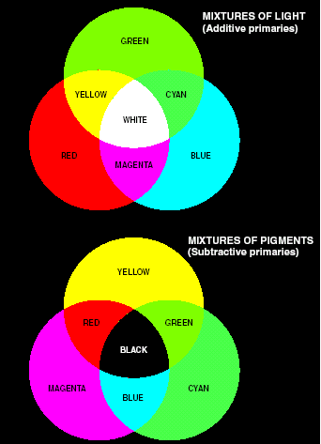
Color Fundamentals
Primary and secondary color of light and pigments
CUI, Lahore Campus -- CSC 331: Digital Image Processing -- © Dr. Usama Ijaz Bajwa

Slide 3


Color Fundamentals
  RGB CMY(K)
CUI, Lahore Campus -- CSC 331: Digital Image Processing -- © Dr. Usama Ijaz Bajwa

Slide 4
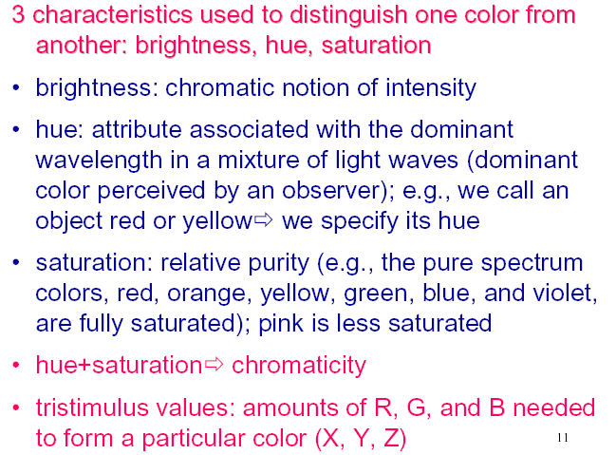
Color Fundamentals
CUI, Lahore Campus -- CSC 331: Digital Image Processing -- © Dr. Usama Ijaz Bajwa

Slide 5
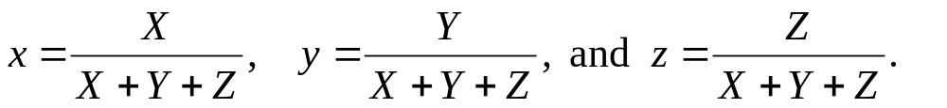

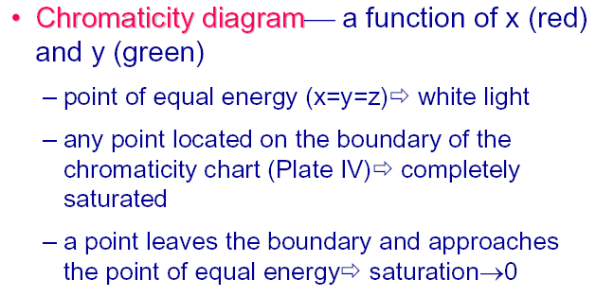
Color Fundamentals
Tri-chromatic coefficients: portions of R, G, and B (x, y, z)
CUI, Lahore Campus -- CSC 331: Digital Image Processing -- © Dr. Usama Ijaz Bajwa

Slide 6
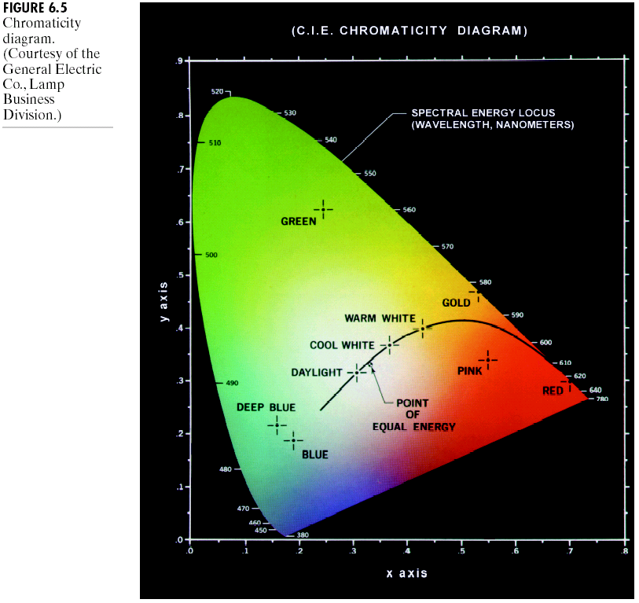
Color Fundamentals
Chromaticity diagram
CUI, Lahore Campus -- CSC 331: Digital Image Processing -- © Dr. Usama Ijaz Bajwa

Slide 7
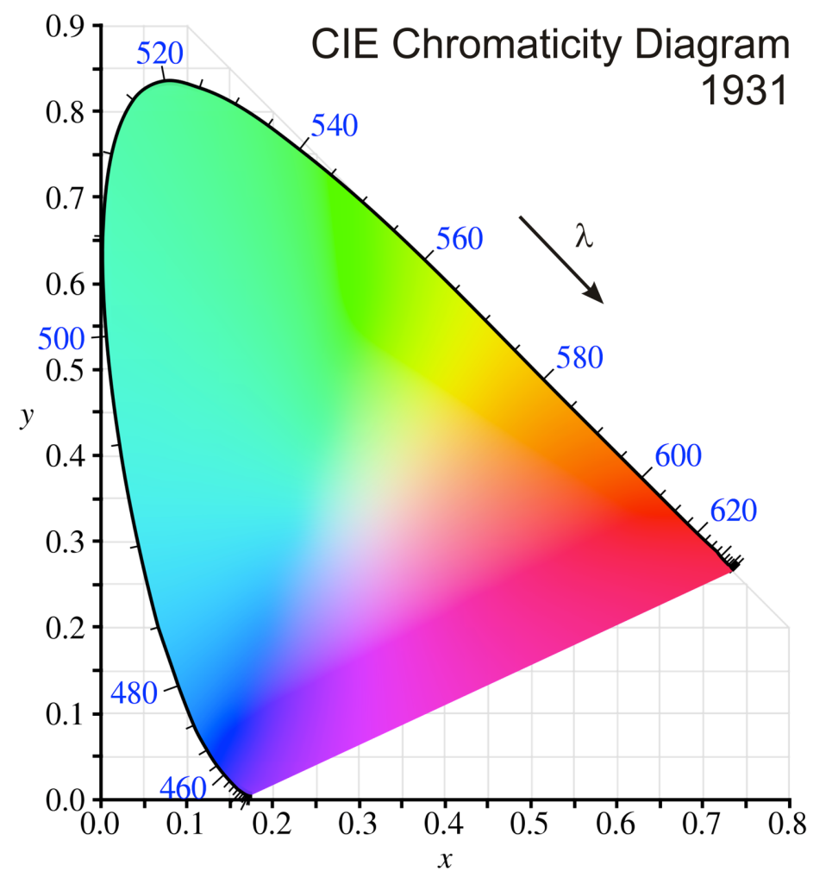
Color Fundamentals
CUI, Lahore Campus -- CSC 331: Digital Image Processing -- © Dr. Usama Ijaz Bajwa

Slide 8
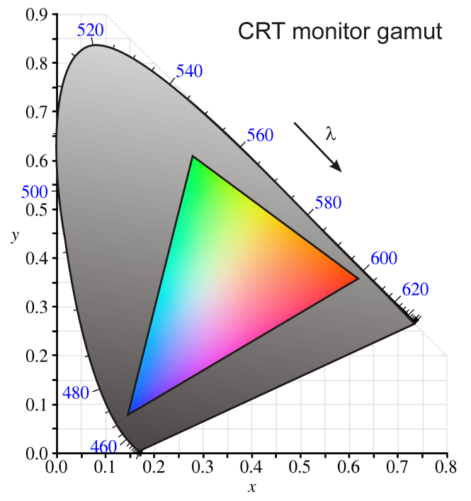
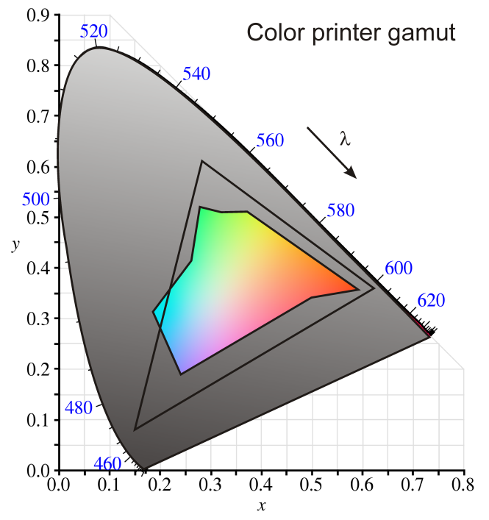
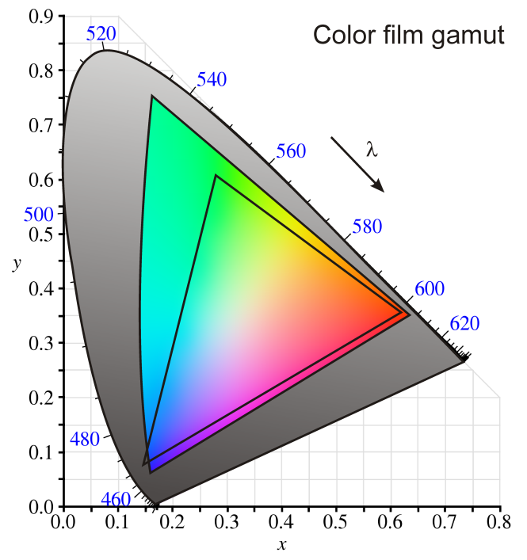
Color Fundamentals
CUI, Lahore Campus -- CSC 331: Digital Image Processing -- © Dr. Usama Ijaz Bajwa

Slide 9
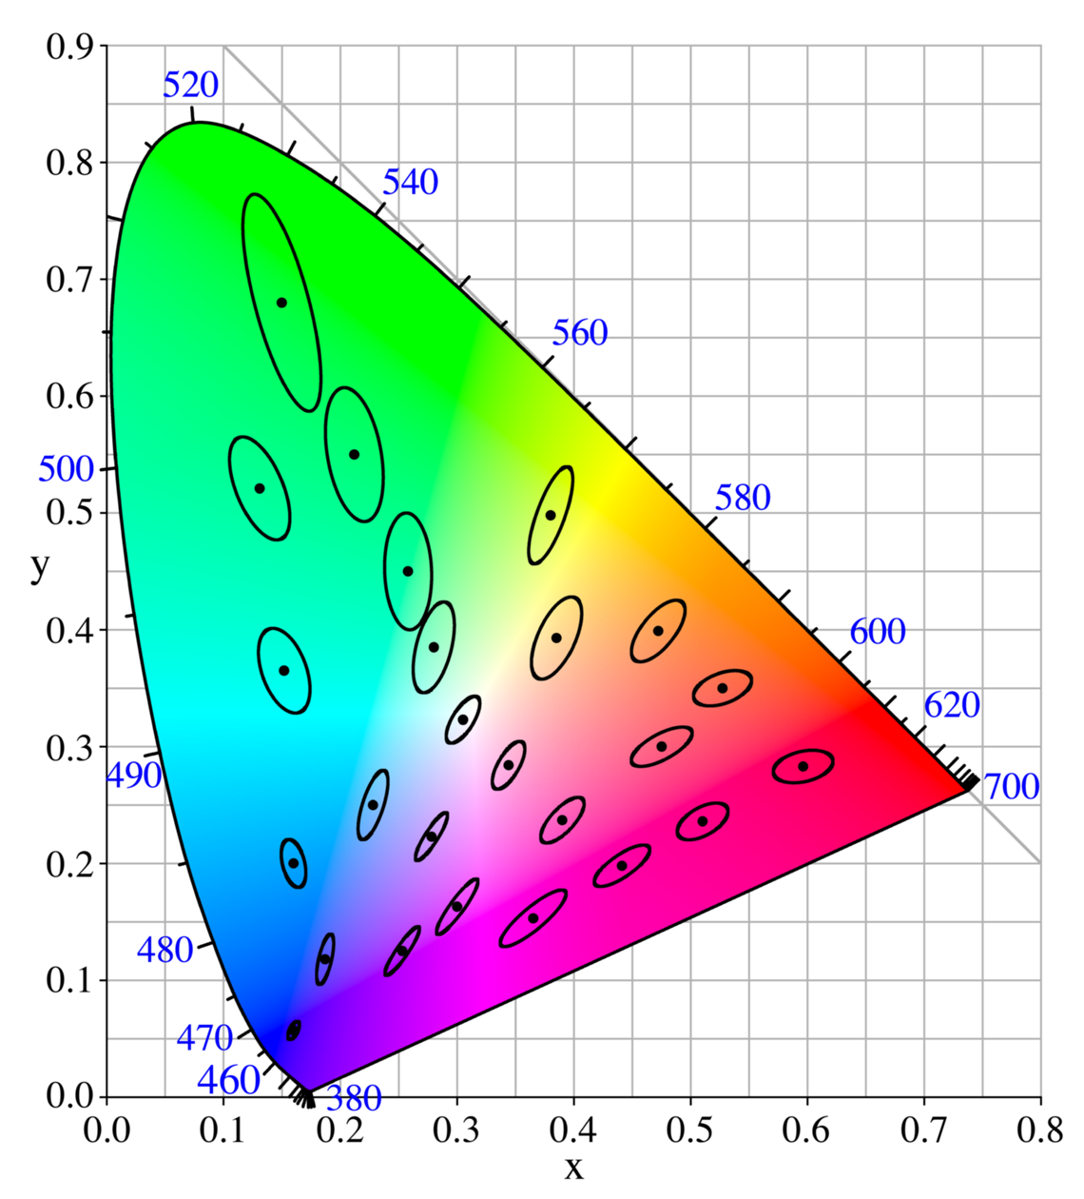
Color Fundamentals
MacAdam ellipses
  Regions on the chromaticity diagram which correspond to all colors which are indistinguishable, to the average human eye, from the color at the center of the ellipse.
  The contour of the ellipse represents the just noticeable differences (JNDs) of chromaticity.
CUI, Lahore Campus -- CSC 331: Digital Image Processing -- © Dr. Usama Ijaz Bajwa

Slide 10
Color Models
A color model (also called color space or color system) is a specification of a coordinate system and a subspace within that system where each color is represented by a single point.
Many color models have been proposed during the last 400 years!
Contemporary color models have also evolved to specify colors for different purposes (e.g., photography, physical measurements of light, color mixtures, etc.).
CUI, Lahore Campus -- CSC 331: Digital Image Processing -- © Dr. Usama Ijaz Bajwa

Slide 11
Color Models
To facilitate the specification of colors, a color model is used to specify a 3D coordinate system for color representation
  Hardware-oriented color models: RGB model for color monitors and color video cameras (Computer Graphics)
  CMY(K) model for color printers
  PhotoYCC model used in PhotoCD production
  YIQ, YUV and YCbCr models for color TV broadcast (Video)
  HSI model decouples the color and the gray scale information and closely corresponds to the human eye interpretation of colors.
CUI, Lahore Campus -- CSC 331: Digital Image Processing -- © Dr. Usama Ijaz Bajwa

Slide 12
RGB Color Model
3 coordinates: red, green, blue, normalized to [0,1] (unit cube)
  3 corners: cyan, magenta, yellow
  origin: black, (1,1,1): white
Images in RGB model: 3 independent image planes (red, green, blue) that can be processed independently.
Typically used in the image sensors and image displays such monitors.
A useful application:
Processing of aerial and satellite multi-spectral image data (one frame consists of multiple digital images taken through different spectral ranges) each image plane has specific physical meaning; useful for image segmentation (based on spectral components)
CUI, Lahore Campus -- CSC 331: Digital Image Processing -- © Dr. Usama Ijaz Bajwa

Slide 13
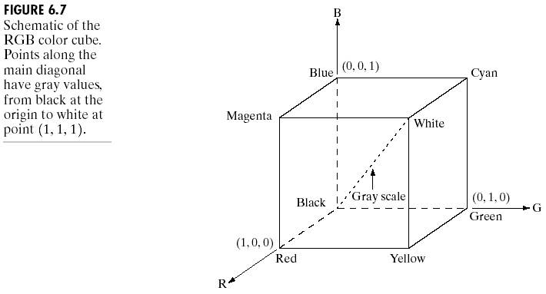
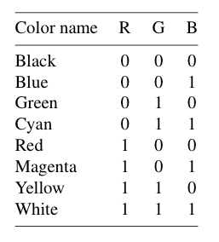
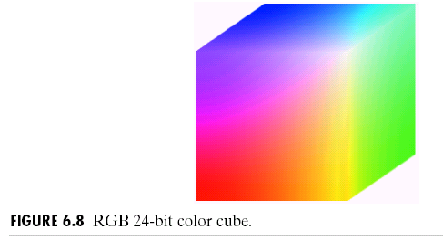
RGB Color Model
CUI, Lahore Campus -- CSC 331: Digital Image Processing -- © Dr. Usama Ijaz Bajwa

Slide 14
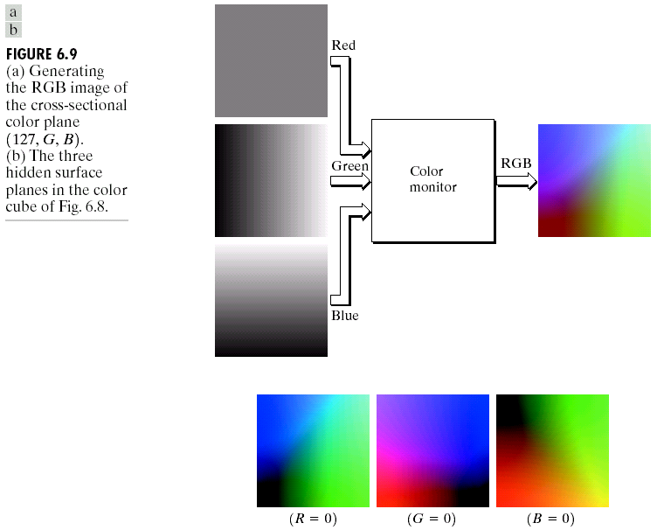
RGB Color Model
CUI, Lahore Campus -- CSC 331: Digital Image Processing -- © Dr. Usama Ijaz Bajwa

Slide 15
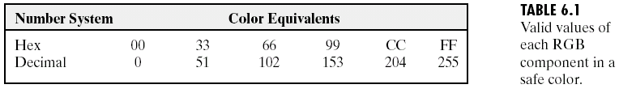
RGB Color Model
Safe colors in RGB
  Many systems are limited to 256 colors although 24-bit RGB image is available
  The set of safe (or, the set of all-systems-safe) RGB colors A subset of colors that are likely to be reproduced faithfully (reasonably independently of viewer hardware capabilities)
  Out of 256 colors, 216 colors are commonly used in all type of operating systems. Each of these 216 colors is the combination of 3 RGB values. For these 216 colors the RGB values can only be: 0, 51, 102, 153, 204, 255.
CUI, Lahore Campus -- CSC 331: Digital Image Processing -- © Dr. Usama Ijaz Bajwa

Slide 16
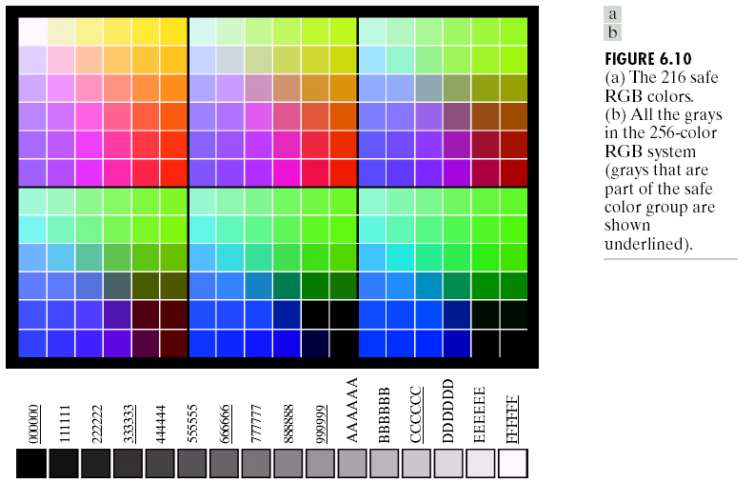
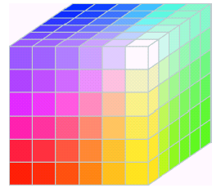
RGB Color Model
RGB safe color cube
CUI, Lahore Campus -- CSC 331: Digital Image Processing -- © Dr. Usama Ijaz Bajwa

